Slide 1
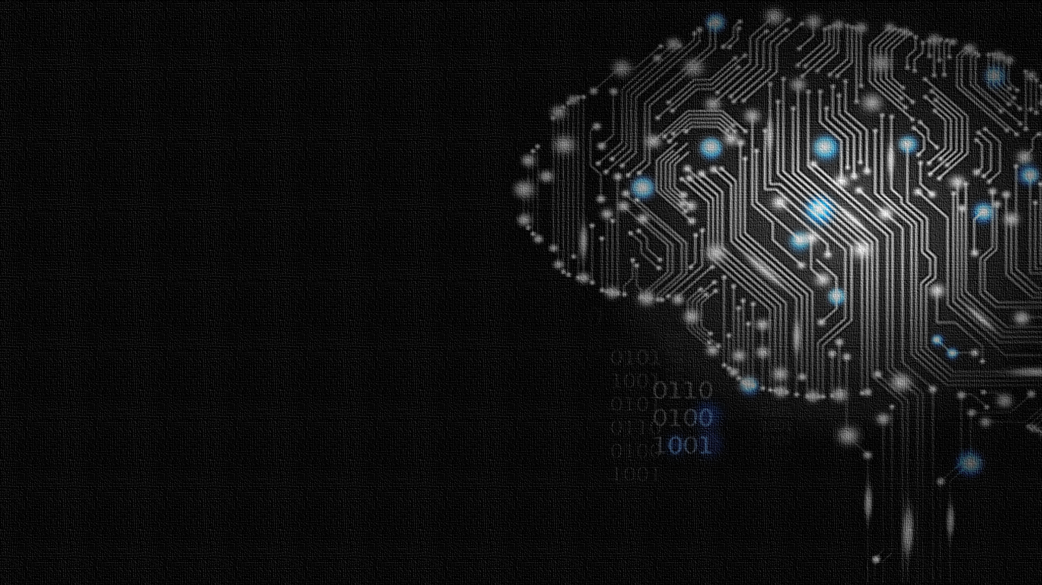
Robotics Simulator for Artificial Intelligence Course
Advisor: Dr. Michel Pasquier
Students:
Issa Haddad
Firas Sardast
Omar Al-Nabulsi

Slide 2
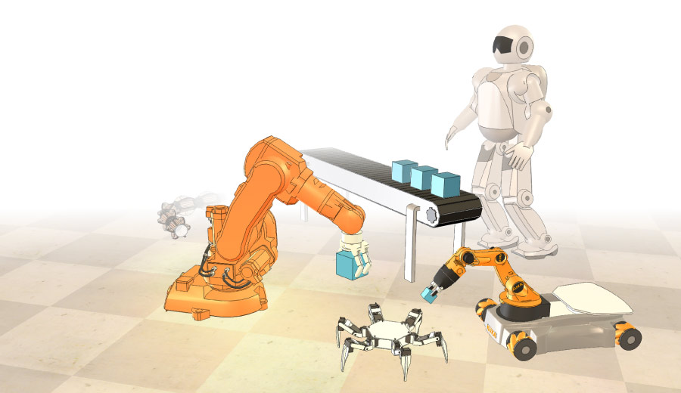
V-rep simulator
Done by Coppelia robotics

Slide 3
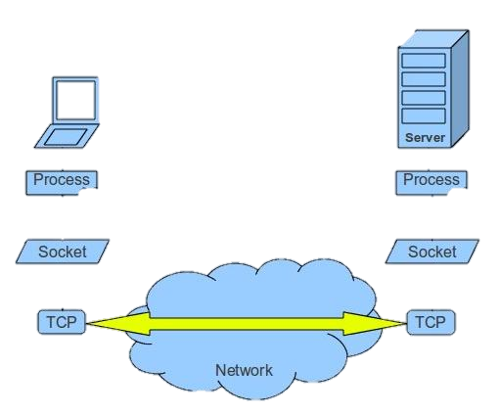
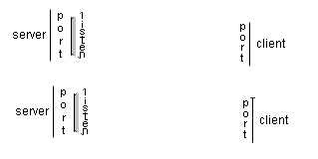
V-rep’s remote API
V-rep provides a remote API with 100+ functions.
Interaction between V-rep and remote API happens through socket communication.
Connection request
connection

Slide 4
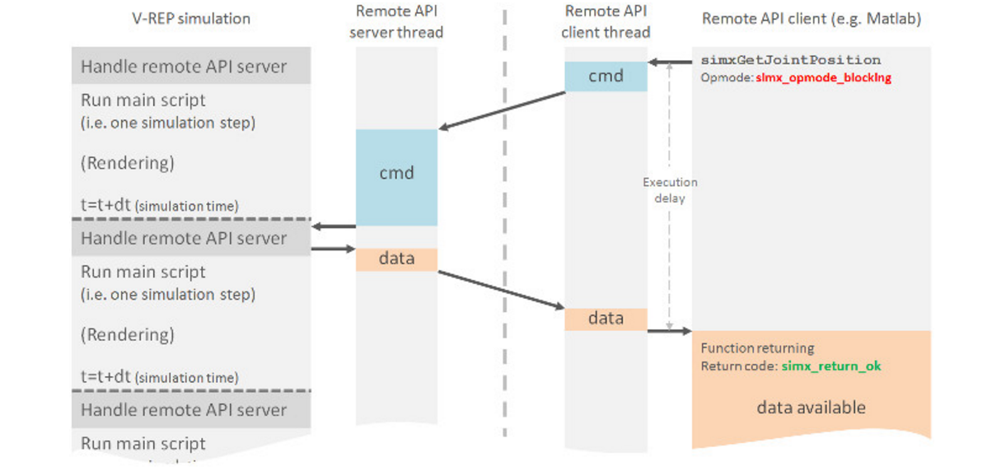

Integration of V-rep
Integrated V-rep with Spyder
Spyder is a python IDE
Connected to each other using sockets:
V-rep → server
Spyder → client

Slide 5
V-rep simulator
Environment
Agent
Functions

Slide 6
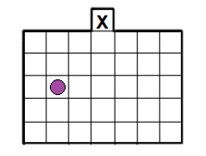
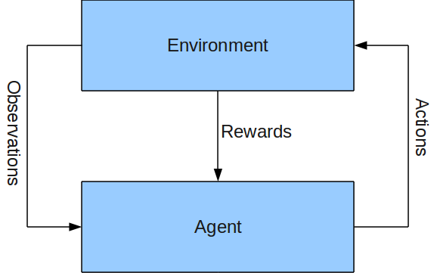
environment

Slide 7
agent
Proximity
wheels
Shape
Joints
sensors
scripts

Slide 8
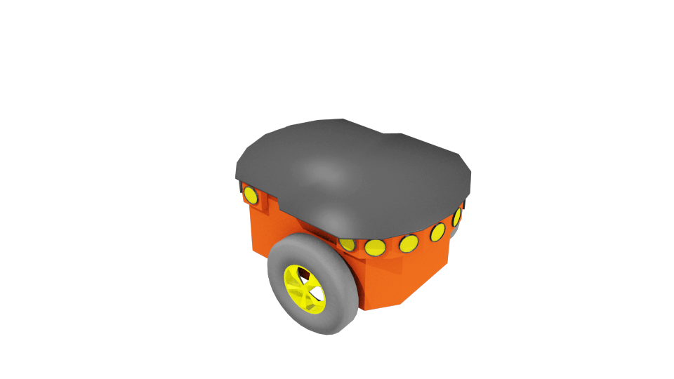
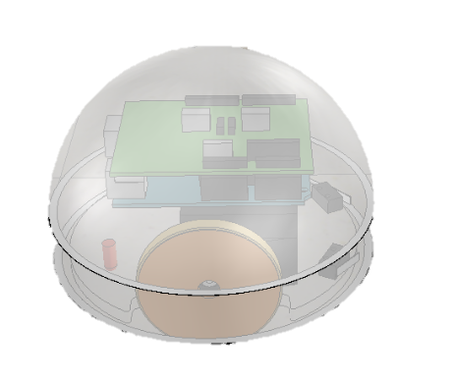
Agent
Lumibot Robot
Pioneer Robot

Slide 9
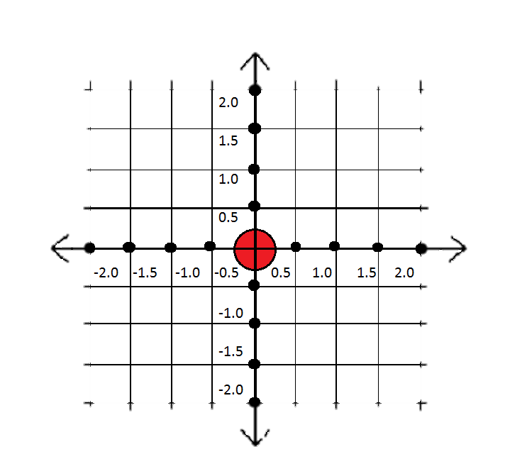
functions
Move Forward
Rotate Right
Rotate Left
Stop
Get Sensor Value

Slide 10
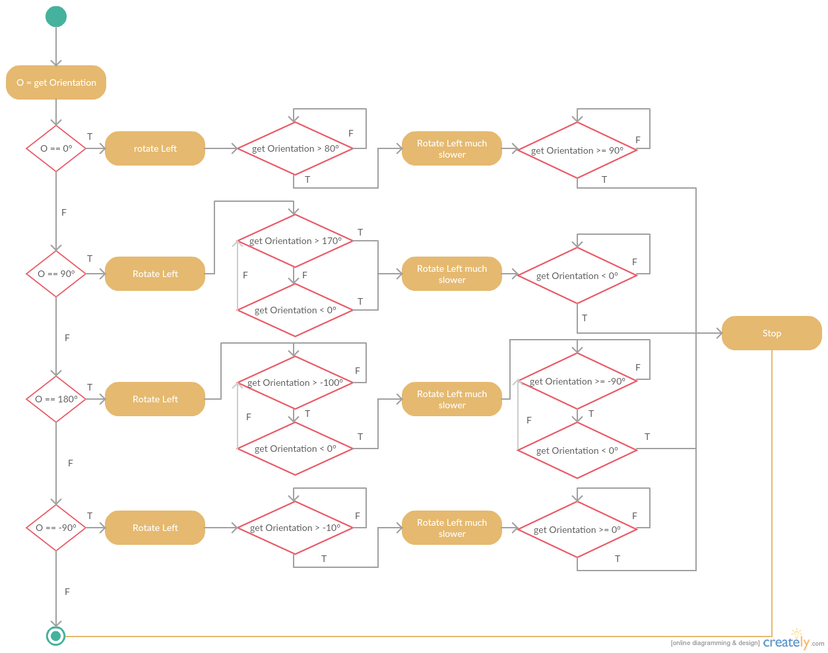
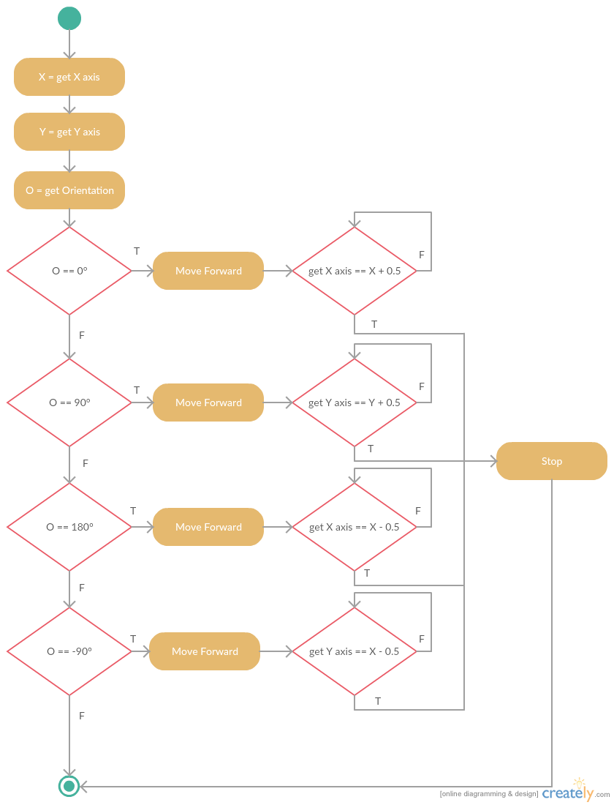
functions

Slide 11
Python class functions → Developer
Class lumibot (object)
Vrep.simxFinish(-1)
Self.clientID = vrep.simxStart (‘127.0.0.1’,19999,True,True,5000,5)
def function name (self):
vrep.simxCallScriptFunction (self.clientID, Robot name, vrep.sim_scripttype_childscript, Function name in v-rep,[self.x],[],[],' ', vrep.simx_opmode_streaming);
vrep.simxCallScriptFunction: Remotely calls a V-REP script function
self.clientID
Robot name

Slide 12
Python class functions → Developer
def function name (self):
vrep.simxCallScriptFunction (self.clientID, Robot name, vrep.sim_scripttype_childscript, Function name in v-rep,[self.x],[],[],' ', vrep.simx_opmode_streaming);
- testmf()
- testtl()
- testtr()
- moveforward()
- turnleft()
- turnright()

Slide 13
Python class functions → Developer
def function name(self):
returnCode,handle=vrep.simxGetObjectHandle(self.clientID,name of sensor, vrep.simx_opmode_blocking)
returnCode2, detectionState, detectedPoint, detectedObjectHandle, detectedSurfaceNormalVector = vrep.simxReadProximitySensor (self.clientID , handle,vrep.simx_opmode_streaming);
return detectionState
- testsensorfront()
- testsensorright()
- testsensorleft()
- Proximity sensor 5
- Proximity sensor 6
- Proximity sensor 3

Slide 14
Python class functions → user
testmf()
will move the agent forward for a single step.
testtl()
will rotate the agent to the left in its place.
Will rotate the agent to the right in its place
testtr()
sensors()
Will return the values of the front/right/left sensors as Boolean
testsensorfront()
Will return the value of the front sensor as Boolean
testsensorleft()
Will return the value of the left sensor Boolean

Slide 15
question
Consider a simple reflex agent that is a mobile robot operating in the grid environment shown below. The robot’s position can only be a grid cell and its orientation is either facing north, east, south, or west. The only possible actions are: move forward (into the next square), turn left and turn right (in place). The agent uses two sensors, and it has a memory, that stores percepts in the previous step.

Slide 16
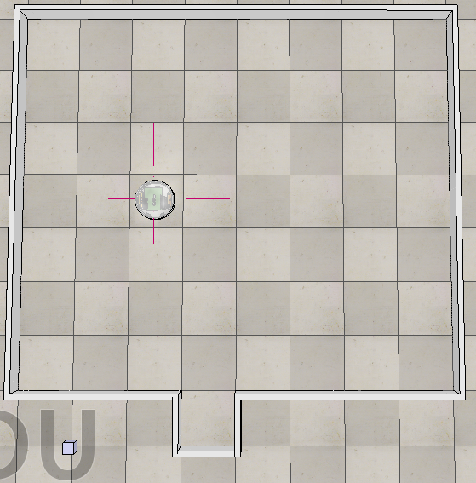
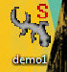
scene

Slide 17
Work to be done
Include class lumibot that we created.
Create the required variables and array.
Use the available movement and sensor functions.
testmf()
will move the agent forward for a single step.
testtl()
will rotate the agent to the left in its place.
Will rotate the agent to the right in its place
testtr()
sensors()
Will return the values of the front/right/left sensors as Boolean

Slide 18
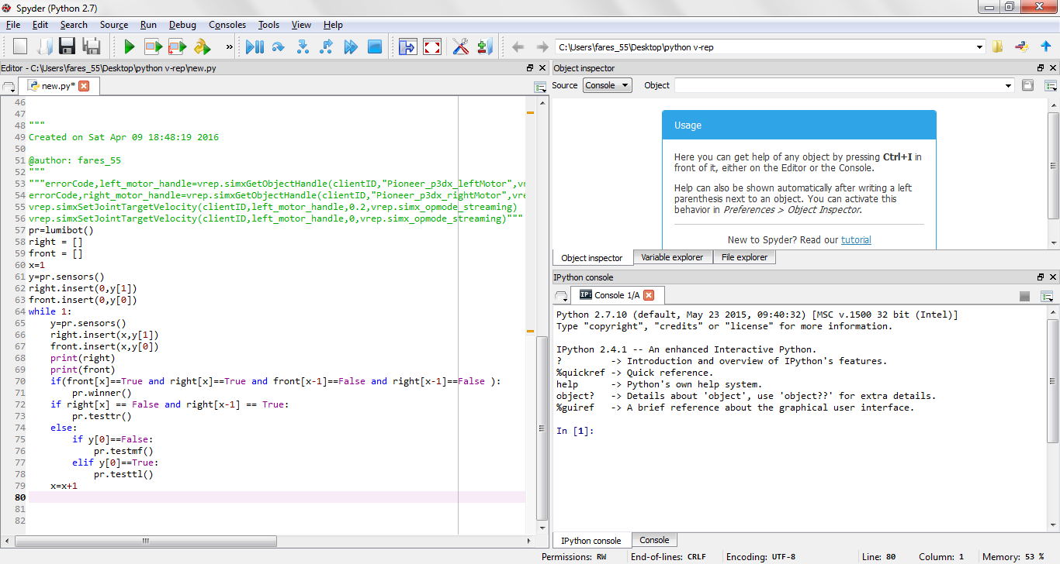
Solution code

Slide 19
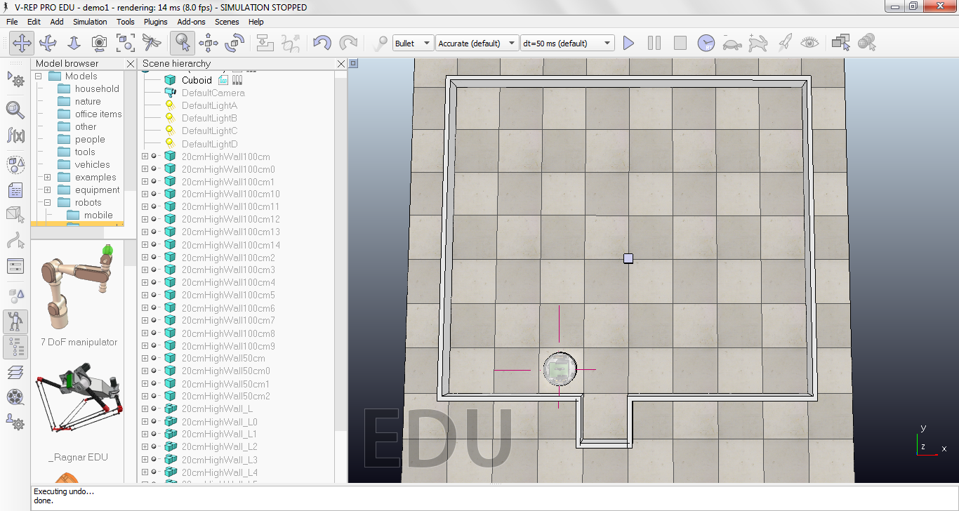


Important part of the code
if(front[x]==True and right[x]==True and front[x-1]==False and right[x-1]==False ):
if right[x] == False and right[x-1] == True:
pr.testtr()
else:
if y[0]==False:
pr.testmf()
elif y[0]==True:
pr.testtl()
2
1
3

Slide 21
Thank you for listening!

